Slide 1
High-Context vs. Low-Context
A Cultural Comparison of Mexico and Norway

Slide 2
What is culture
Culture is the complex whole of shared beliefs, values, customs, and behaviors that define a group or society. It includes the knowledge, arts, laws, and habits acquired by individuals as members of that society, encompassing both non-physical elements like traditions and beliefs, and physical ones like art and cuisine. Culture shapes how a group of people understand and interact with the world, and it is learned, shared, and dynamic, evolving over time.

Slide 3
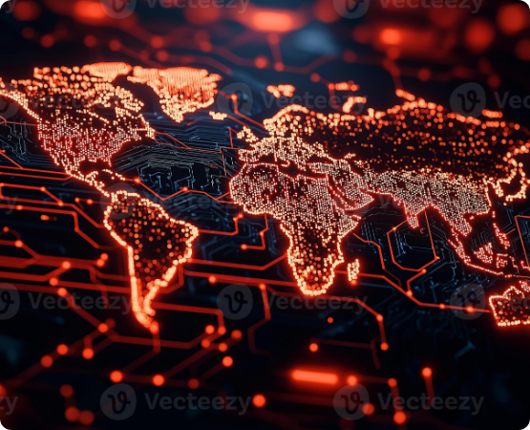

The Context Spectrum
Developed by anthropologist Edward T. Hall, this concept describes how cultures handle communication and the transmission of meaning.
High-Context: Meaning is largely implicit, found in the physical context, shared history, and non-verbal cues. Relationships are foundational.
Low-Context: Meaning is explicit and conveyed through the verbal message itself. Communication is direct and task-oriented.

Slide 4
High and Low – Context Cultures
High
East Asia: Japan, China, South Korea
Latin America: Brazil, Mexico, Argentina
South Asia: India
Middle East: Saudi Arabia
Africa: Egypt
Europe: France, Spain, Italy, Greece, Russia
Low
North America: The United States, Canada
Oceania: Australia, New Zealand
Europe: Germany, Switzerland, Scandinavia (Denmark, Norway, Sweden), the Netherlands, the United Kingdom, Belgium

Slide 5
Part 1: Low-Context
Norway

Slide 6





Norway: Communication
Direct & Explicit
Verbal Focus
Task-Oriented Conflict
Messages are literal and precise. Ambiguity is avoided. People "say what they mean" and expect clarity in return.
Meaning is conveyed through the words themselves, not heavily reliant on tone or body language. Written rules are followed.
Disagreements are handled directly and explicitly, focusing on the issue or task, not the person involved.

Slide 7

Norway: Society & Business
Individualism: Focus on personal achievement, independence, and immediate family.
Egalitarian: A very flat social structure (low power distance). First names are used regardless of rank.
Trust in Systems: High trust is placed in institutions, rules, and contracts. Agendas are followed strictly.
Punctuality: Being on time is extremely important and seen as a sign of respect and reliability.

Slide 8
Part 2: High-Context
Mexico

Slide 9



Mexico: Communication
Implicit & Non-Verbal
Relationship Focus
Saving "Face"
Much of the meaning is "read between the lines," derived from tone, gestures, and shared context.
Building rapport (confianza) is essential. The way something is said is as important as what is said.
Direct conflict is avoided to maintain harmony and protect everyone's honor. A "no" is often said indirectly.

Slide 10

Mexico: Society & Business
Collectivism: Priority is given to the group (family, team, company). Loyalty is paramount.
Hierarchical: Respect for authority, age, and rank is important (high power distance). Titles are often used.
Trust in People: Personal relationships and trust are the foundation for all business dealings.
Flexible Time: Socializing and relationship-building can take precedence over strict schedules.

Slide 11
At Glance: Norway vs. Mexico
Feature | Norway (Low-Context) | Mexico (High-Context)
Primary Meaning | Explicitly stated in words | Implicitly found in context & non-verbals
Communication | Direct, precise, and literal | Indirect, nuanced, and layered
Relationships | Separate from tasks | Essential for tasks
Hierarchy | Egalitarian (Flat) | Hierarchical (Respected)
Trust | Placed in Systems & Rules | Placed in People & Relationships

Slide 12
Hofstede dimensions of culture
Hofstede's cultural dimensions theory is a framework for understanding cultural differences across countries based on six dimensions:
1- Power Distance
2-Individualism versus Collectivism
3-Masculinity versus Femininity
4-Uncertainty Avoidance
5-Long-Term versus Short-Term Orientation
6-Indulgence versus Restraint.
Developed by Geert Hofstede, the model analyzes how cultural values influence behavior in society and the workplace

Slide 13
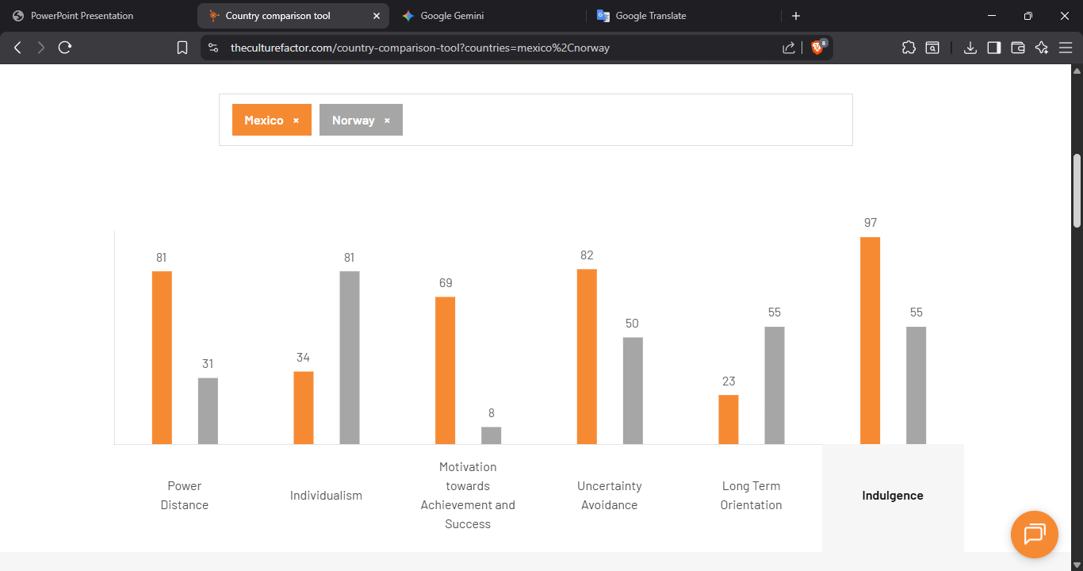

Slide 14


Potential Misunderstandings (Culture Shock)
How Norway May See Mexico
How Mexico May See Norway
Vague or unclear
Blunt, cold, or rude
Inefficient or slow
Impersonal and distant
Lacking directness
Overly simplistic
Mixing business and personal life
Inflexible and rule-bound

Slide 15

Stereotyping vs. Understanding
Stereotypes are harmful, fixed shortcuts (e.g., "Cold Vikings," "Lazy Mexicans").
Cultural models (like high/low context) are tools for understanding, not labeling.
They describe "on average" tendencies, not all individuals.
Goal: See behavior as a product of cultural norms, not personal flaws.

Slide 16


How to Avoid Violating Values
In Norway (Low-Context)
In Mexico (High-Context)
DO: Be punctual, be direct and honest, respect personal space.
DO: Build rapport first, accept hospitality, show respect for hierarchy.
AVOID: Vague answers, excessive small talk in business, assumptions of hierarchy.
AVOID: Being blunt, rushing to business, causing someone to 'lose face'.

Slide 17


Nuances: Slang & Humor
Slang (Norway 🇳🇴)
Slang (Mexico 🇲🇽)
Best avoided in business. Clarity and formal language are valued.
Very common, but high-risk for outsiders. Signals in-group status.
Humor (Norway 🇳🇴)
Humor (Mexico 🇲🇽)
Often dry, sarcastic, and direct. Can be misunderstood as actual criticism.
Warm, relational, and teasing. Used to build confianza (trust).

Slide 18

Gender Egalitarianism
A significant point of difference in the professional world.
NORWAY: Consistently ranks in the top 5 globally for gender equality. Leadership roles are balanced. Treat all colleagues as equals.
MEXICO: More traditional roles ("machismo") can still influence culture. Business is male-dominated in many sectors, but professional women hold significant power.

Slide 19





Global Etiquette: Key Differences
Greetings
Personal Space
Gifts & Hospitality
NOR: Firm, brief handshake, direct eye contact.
MEX: Warm handshake, often a hug ('abrazo') or cheek kiss.
NOR: Value a larger 'bubble' of personal space.
MEX: Closer proximity is common and signals warmth.
NOR: Gifts are rare in business.
MEX: Hospitality is crucial. Accepting food/drink is vital.

Slide 20


Time: Punctuality & Perception
Monochronic (Norway)
Polychronic (Mexico)
Time is linear and literal (e.g., CET). Punctuality is rigid. Being late is disrespectful. Stick to the agenda.
Time is flexible and relational (e.g., CST/MST). Relationships are more important than schedules. Agendas are a guide.

Slide 21
Summary: Norway vs. Mexico
Topic | Norway (Low-Context) | Mexico (High-Context)
Values | Clarity, Punctuality, Equality | Harmony, Relationships, Hierarchy
Humor | Dry, Sarcastic, Direct | Warm, Relational, Teasing
Etiquette | Reserved, Formal, Large Space | Warm, Expressive, Close Space
Time | Monochronic (Linear) | Polychronic (Flexible)
Slang | Avoid in Business | Common In-Group Signal

Slide 22

Bridging the Gap
Effective intercultural communication requires moving beyond assumptions.
Awareness: Recognize that your "normal" is not universal.
Flexibility: Be prepared to adapt your style to the situation.
Curiosity: Ask questions to clarify meaning rather than assuming intent.

Slide 23
Thank you

